Slide 1
HR Analysis

Slide 2
Business PROBLEM
To create equality in company workforce. With various factors like gender, race, pay rate, and other factors, the company needs to end inequality in all its forms.

Slide 3
METHODOLOGY
Data was collected from the following servers
  Local HR Database
Tools used for analytics:
  Excel, Power BI
Steps taken to clean data
  Inserting functions, removing blank cells, changing values to correct format, creating new columns.
Perform Analysis
  On Power BI I transformed the data further, performed statistical analysis and loaded datasets. I further modelled data an created visuals.

Slide 4
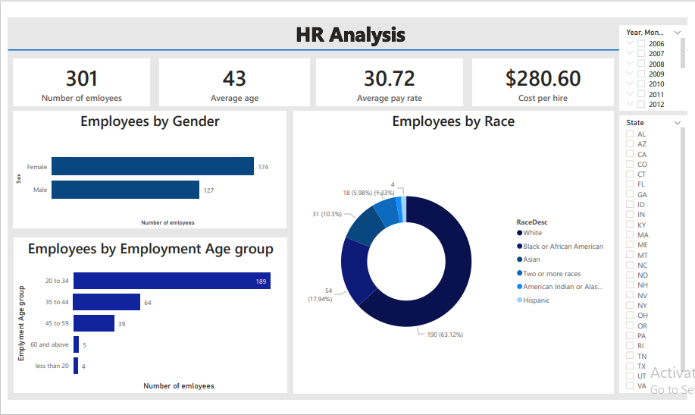
HR ANALYSIS OVERVIEW

Slide 5
Analysis
I performed an analysis on the HR dataset to see if there were any inequalities and my findings were as follows:
  Firstly the opportunities between females and males are not equal as the percentage of employed females is 58%.
  Secondly, about 63% of the employees in the dataset are white, according to race description.
  Most employees are single and are within the ages of 20 to 45 when they are employed.
  Only 58% of the employees in the dataset are still actively employed, and in the other 48%, most people have left for better opportunities.
  Lastly there is pay rate gaps between races, sex and positions occupied.

Slide 6
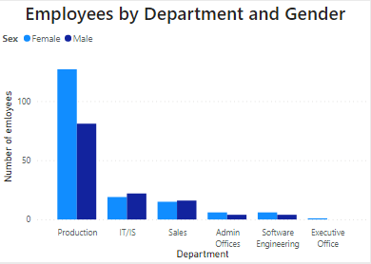
Number of employees by sex
  There is significant gap between female and male employees with females taking up over 57% of the work force.
  However most females are in the Production department, which has the lowest pay scale.

Slide 7
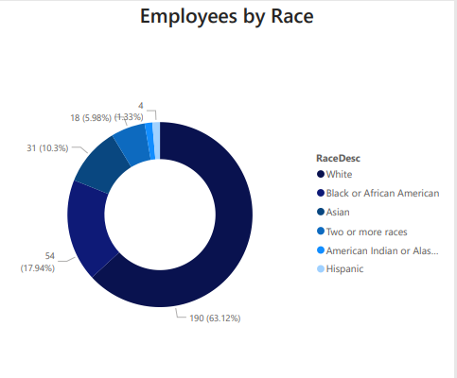
Number of employees by race description
  Over 60% of the employees are white people, and the other 37% is split between other race like Asian, Blacks, American, etc.
  Considering that 90% of the work force is U.S citizens, there is clearly inequality in race in this company

Slide 8
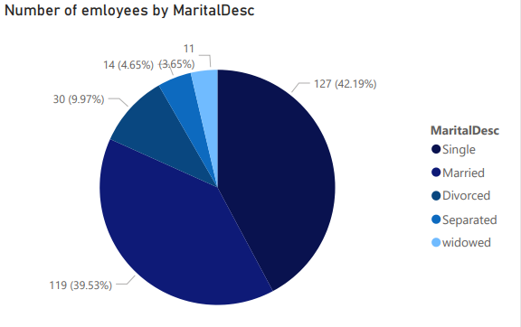
Number of employees by Marital description
  There is a inequity on Divorced, Widowed, and separated individuals in the company.

Slide 9
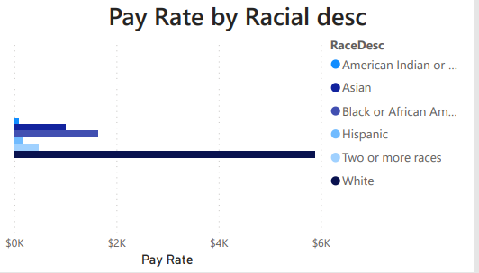
Pay rate by Racial Description

Slide 10
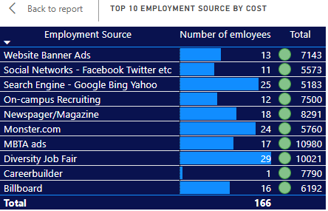
Top 10 employment sources by cost and number of employees

Slide 11
INSIGHT
While there is high number of female employees, they are mostly in the Production department which has the lowest pay rate. The top 10 pay rate in this department are 9 white males and one white female.
Females who occupy the leadership positions like CIO and President have a very low pay rate for the assumed position.
There is a pay rate gap between racial groups, with whites earning more than 40% more than other races. Again white males also have the high pay rates than females.
There is misallocation of funds in the hiring sources used. Spending $7700 on one employee, while spending $5760 on 24 employees does not make any sense. There is either a discrepancy is misappropriation of funds there.

Slide 12
Recommendations
There should be more females in other department and their pay rates should equate to at least the average pay rate in that role, not less.
The race difference is too high, the hiring managers should focus on getting more Blacks, Indian Americans, Asians, and other races into their work force, especially U.S citizens.
Over the next months, money should be spent on skills development, instead of hiring outside because about 15% of the employees have left because of issues relating to career advancement, more money, etc.
Different roles have different salary ranges, however, there shouldn’t be different pay rates in the same, whether it’s different genders, race or anything else.
The managers need to be trained on creating equality in the workplace, because they contribute greatly on the hiring process, and post hiring culture of the company.

